Slide 1
RESEARCH PROPOSAL
STEP 1: IDENTIFY TOPIC
DONE
SIGNIFICANT IN THE SOCIETY
RELATED TO CS
ENHANCE THE BODY OF KNOWLEDGE

Slide 2
RESEARCH PROPOSAL
STEP 2: INITIAL READING
DONE
PURPOSE
KNOW THE FF:
WHAT IS CURRENT IN THE FIELD OF STUDY
OTHER RELATED RESEARCH
OBJECTIVES
SCOPE
METHOD
ALGORITHM USED
RESULT
RECOMMENDATION
PURPOSE (CONT)
REVISE TOPIC
DON’T REPEAT WHAT IS DONE
NEED TO DETERMINE WHAT WILL BE THE END RESULT OF THE RESEARCH
LOCALIZATION
INCREASE PERFORMANCE
ADDING/CHANGING PARAMETER
SOLVE PROBLEMATIC STEP/S
BASIS
SCOPE
METHOD

Slide 3
RESEARCH PROPOSAL
STEP 3: IDENTIFY PROBLEMS/OBJECTIVES OF THE STUDY
NEED BASIS
FROM RRL
STEP 4: DETERMINE THE SCOPE OF THE STUDY
STEP 5: DEFINE THE METHODOLOGY

Slide 4
SURVEY PAPER

Slide 5
PARTS
Introduction
Terminology
General Research Framework
Paper Surveys
Analysis of Papers (Methodology)
Proposal

Slide 6
INTRODUCTION
A clear description of the field.
What is it a subset of?
What is the current status?
Short history: was there a seminal paper, research funding, special event, invention of an algorithm which spurred the development.
Do not be afraid to anchor your domain in reality
Which are the conferences, workshops, journals, special editions which are carrying the papers related to the topic?
Research Challenges

Slide 7
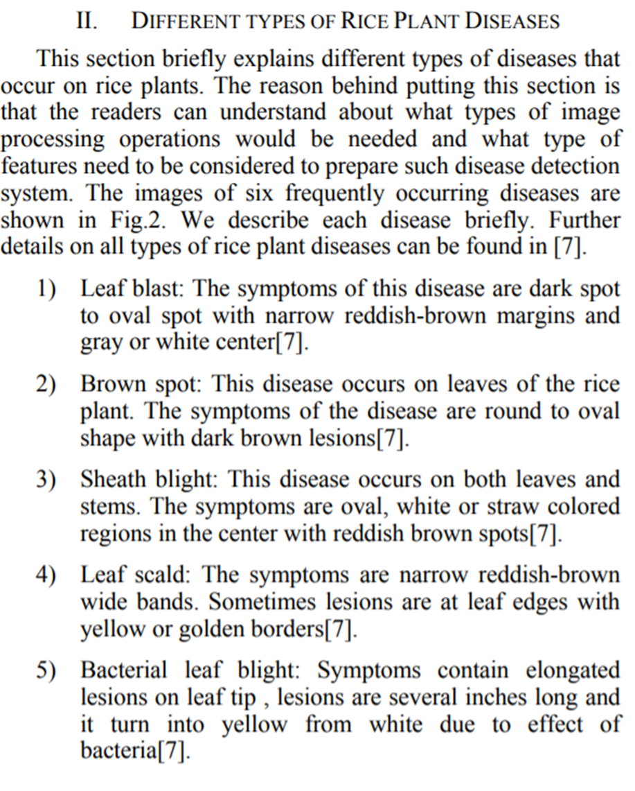
TERMINILOGY
terminology of the field, describe what the various terms mean.

Slide 8
GENERAL RESEARCH FRAMEWORK
General Phases
For example: Image Processing
Image Acquisition
Pre – processing
Image Segmentation
Feature Extraction
Modelling using Machine Learning and others
Testing

Slide 9
Paper survey
Per Paper cited
Scope
Data set
Methodology including the algorithm used
Results
Further research

Slide 10
Analysis of paper survey
Comparison between Paper Cited

Slide 11
Proposal
Proposed Conceptual Framework

Slide 12
Citation
https://www.acm.org/publications/authors/reference-formatting

